Slide 1
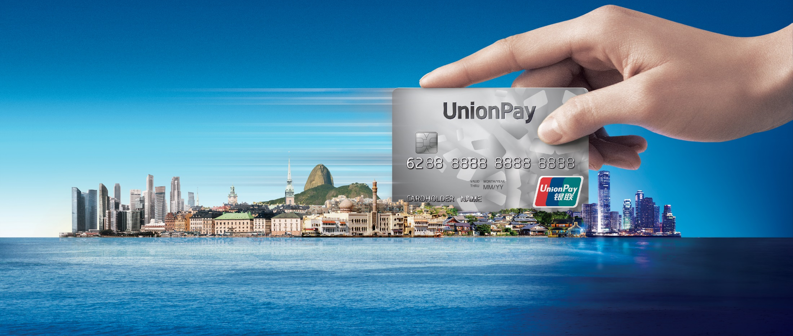


UPI QR Code Payment

Slide 2
The contents shared in this presentation are provided "AS IS" and intended for informational purposes only and should not be relied upon for operational, marketing, legal, technical, tax, financial or other advice. It is intended to be used between UnionPay International and the parties with whom the content is shared; it cannot be distributed nor shared with any other parties. All material mentioned in this presentation is to facilitate discussion between both parties and will not be deemed as an agreement. Assumptions were made by us in light of our experience and our perceptions of historical trends, current conditions and expected future developments and other factors that we believe are appropriate under the circumstance. Recommendations are subject to risks and uncertainties, which may cause actual and future results and trends to differ materially from the assumptions or recommendations. UnionPay International is not responsible for your use of the information contained herein (including errors, omissions, inaccuracy, formatting errors or non-timeliness of any kind) or any assumptions or conclusions you might draw from its use.

Slide 3
01
QR Code Payment Transaction

Slide 4






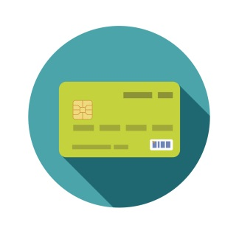
UPI QR Code - Merchant Presented (ISO 8583)
APP
2.0 Scan Merchant QR Code
3.2 Coupon Write-off
UMPS
1.0 Generate QR Code
3.8 TXN Result Notification
3.1 Payment Request
Gateway
4.0 TXN Result Notification
3.3 Payment Request
3.9 Payment Response
Issuer
GSCS
Acquirer
3.5 Payment Request
3.4 Payment Request
3.6 Payment Response
3.7 Payment Response
Notes:
This is how the payment information flows behind the transaction,
Merchant apply a QRC from the Acq, Cardholder use mobile App to scan the QRC.
App initiate a payment request to UPI. UPI transfer the payment request to ACQ, ACQ construct a purchase online message and send to UPI.
The purchase transaction is similar to traditional POS transaction.
After issuer authorized the TXN, and response to the Acq, the Acq shall notify the merchant that the transaction is completed. And response to UPI .
UPI will provide the result notification to the APP

Slide 5

UPI QR Code - Consumer Presented (ISO 8583)
APP
2.0 Scan Merchant QR Code
3.2 Payment Request
UMPS
3.1.0 Coupon Write-off
1.0 Generate QR Code
4.0 TXN Result Notification
Gateway
3.5 Additional Processing
3.9 TXN Result Notification
Issuer
3.8 Payment Response
3.4 Additional Processing
GSCS
Acquirer
3.1.2 Coupon Write-off
3.6 Payment Request
3.1.1 Coupon Write-off
3.3 Payment Request
3.7 Payment Response
3.9 Payment Response
Notes:
This is how the payment information flows behind the transaction,
Merchant apply a QRC from the Acq, Cardholder use mobile App to scan the QRC.
App initiate a payment request to UPI. UPI transfer the payment request to ACQ, ACQ construct a purchase online message and send to UPI.
The purchase transaction is similar to traditional POS transaction.
After issuer authorized the TXN, and response to the Acq, the Acq shall notify the merchant that the transaction is completed. And response to UPI .
UPI will provide the result notification to the APP

